Slide 1

RUNGTA COLLEGE OF DENTAL SCIENCES & RESEARCH
EARLY CHILDHOOD CARIES
DEPARTMENT OF PEDODONTICS AND PREVENTIVE DENTISTRY

Slide 2
Specific learning Objectives
Core areas | Domain
Definition Developmental stages of ECC. Classification | Secondary etiological risk factos of ECC. Pevention Barriers in ECC.

Slide 3
CATEGORY
MUST TO KNOW
NICE TO KNOW
Developmental stages of ECC
DESIRE TO KNOW
Prvention of ECC.
Definition
Overview
Primary etiological risk factors of ECC.
Barriers in ECC.

Slide 4
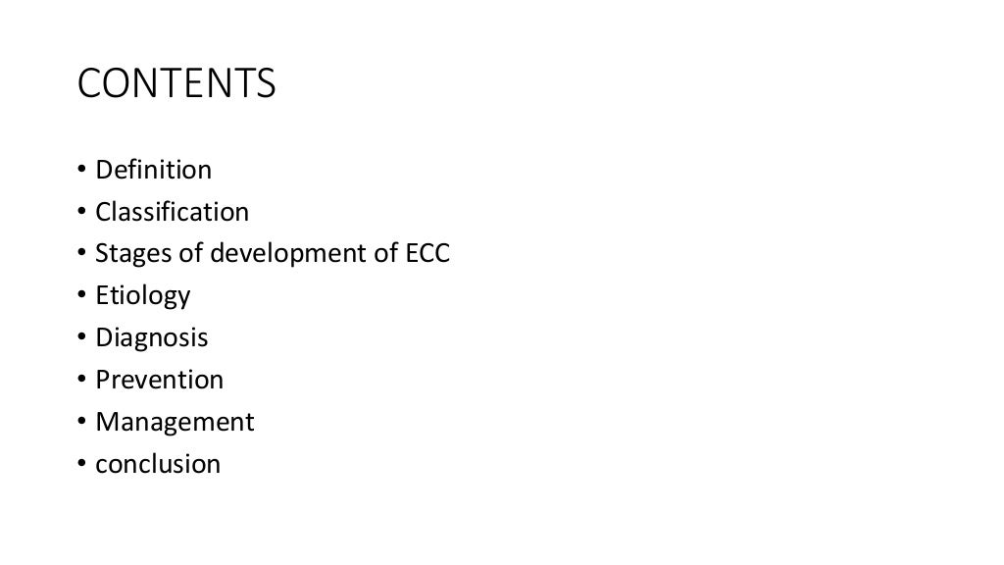

Slide 5
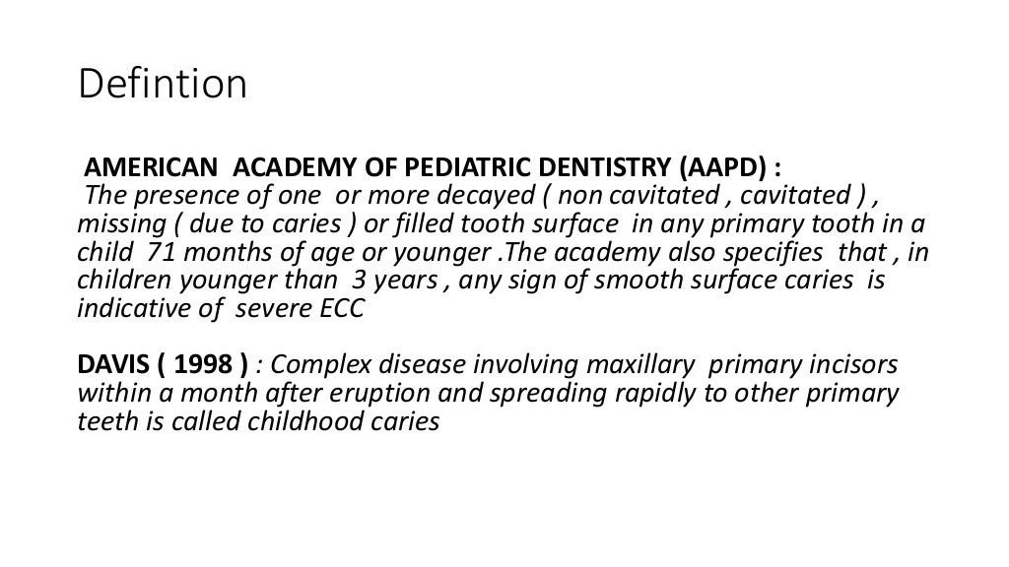

Slide 6
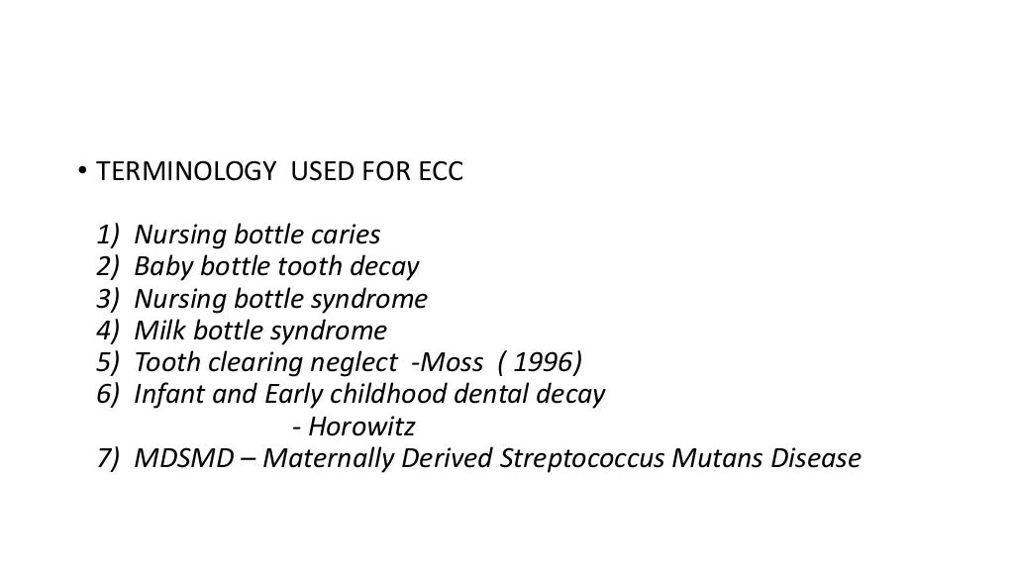

Slide 7
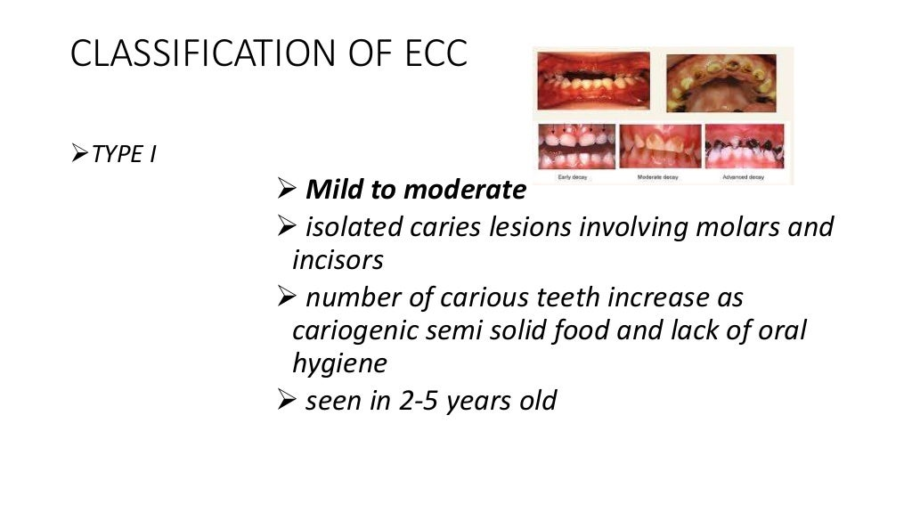

Slide 8
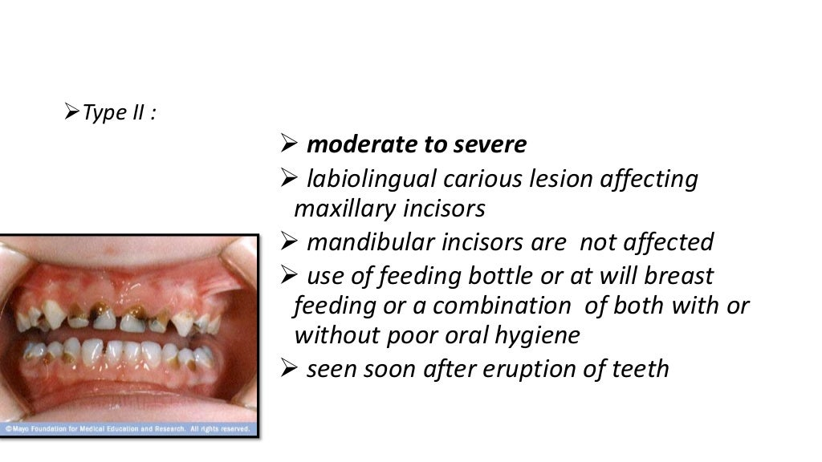

Slide 9
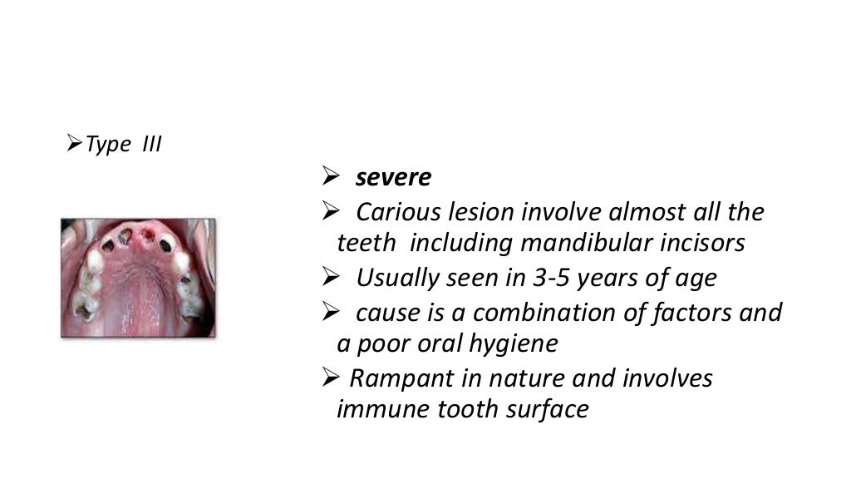

Slide 10
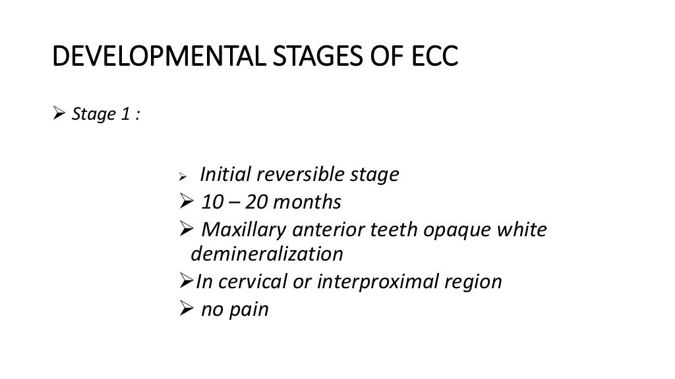

Slide 11
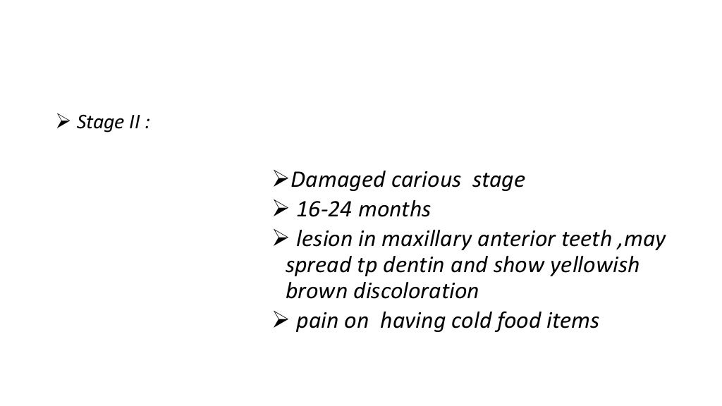

Slide 12
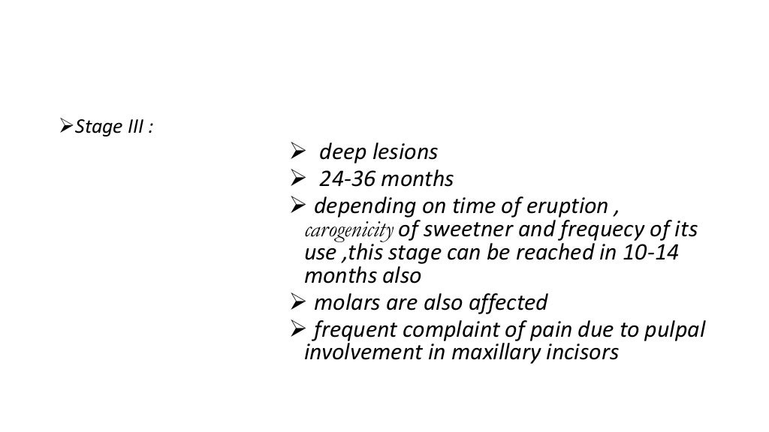

Slide 13
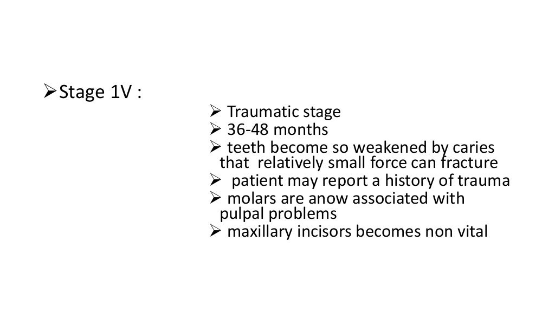

Slide 14
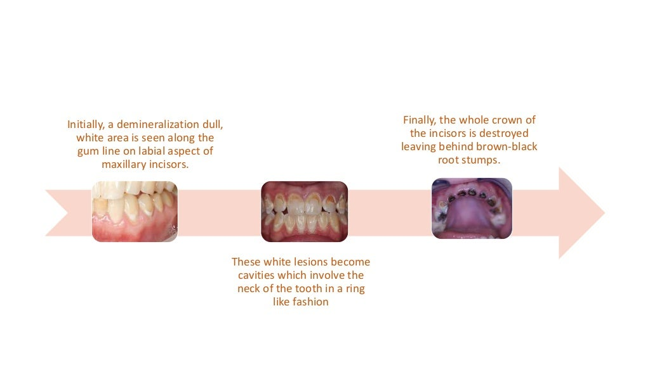

Slide 15
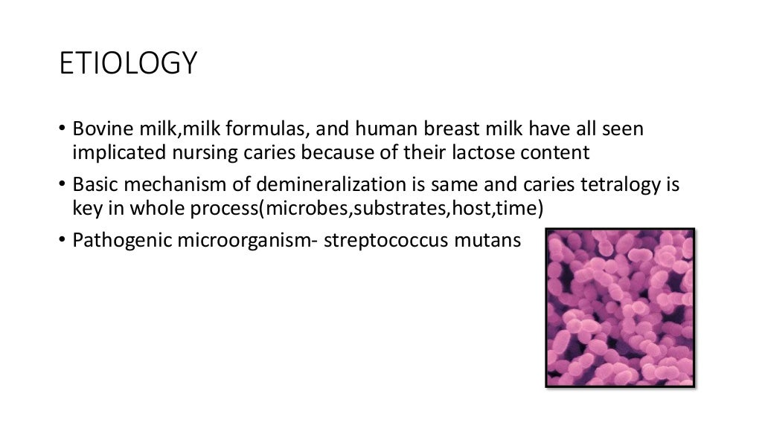

Slide 16
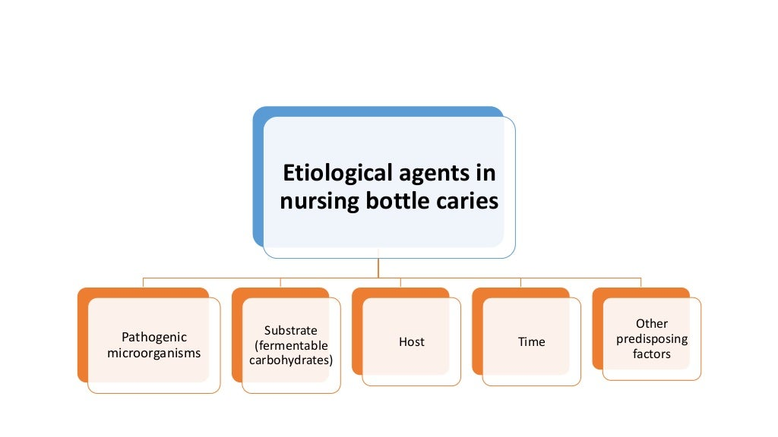

Slide 17
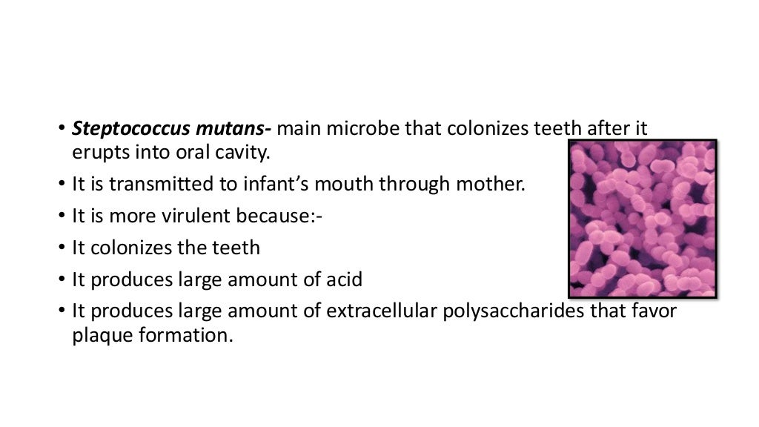

Slide 18
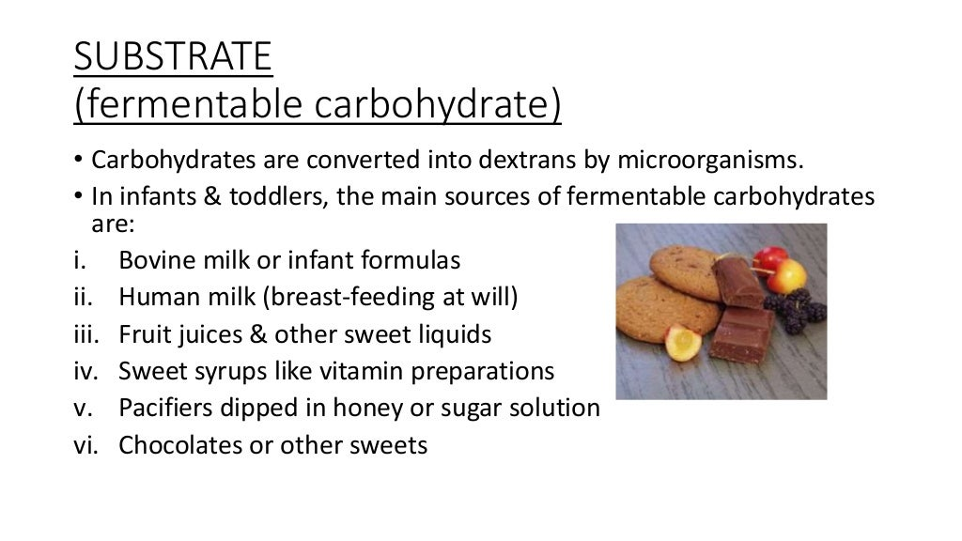

Slide 19
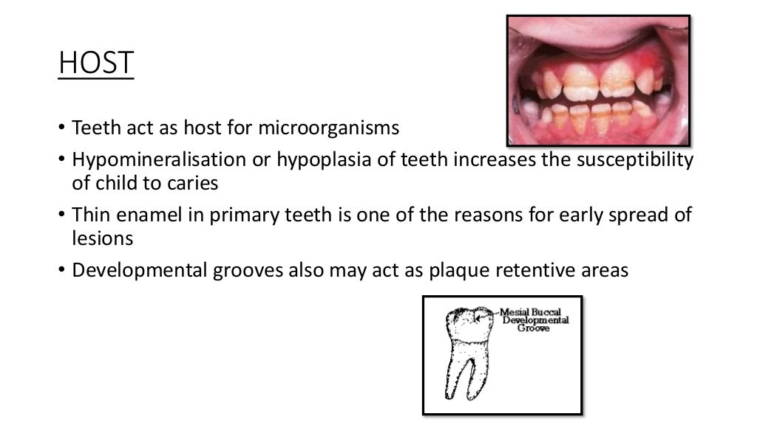

Slide 20
